Slide 1


Device Health Checker

Slide 2




Team Member
Harun
221002138
Shipon
221002098

Slide 3

Index
01
Introduction
02
Why we make this?
03
Implementation
04
Future Works

Slide 4

Introduction
A computer system is build with hardware and software. We can check our system health regularly to see the overall condition of our system. So that we can apply some steps to reduce any unwanted issue.
Main components of a system is:
CPU
RAM
ROM
File Systems etc

Slide 5

Why we make this?
Because sometimes our system losses it’s performence and get hanged. We don’t know that’s the problem. Then we can easily identify our problem by using our this projects. Use make this projects just because of applying our shell script knowledge in real life problem, that’s why we choose this projects which can monitor our system health and give us the report in a html file format.

Slide 6
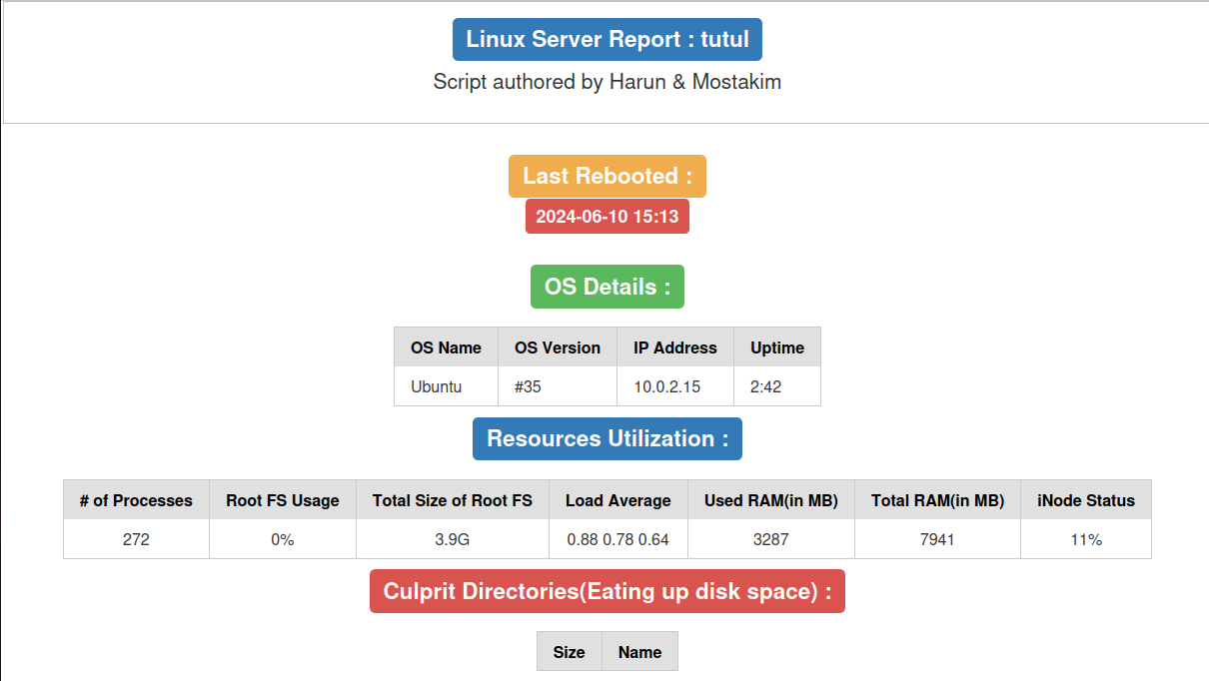
Implementation

Slide 7
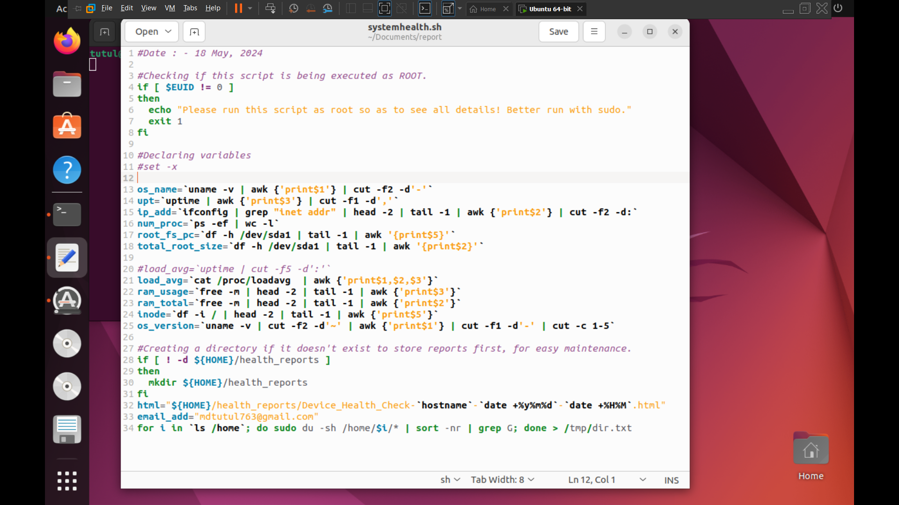
Code

Slide 8

Future Work
Computer Application: • We will make a computer application of our projects in future. •
Real time Monitor: • Though our projects gives us static value we will upgrade realtime dynamic feature of our projects in next update. •
Send Data to Email: • In next update we can add send report to your email feature.

Slide 9


